Slide 1
CSE 12 – Basic Data Structures and Object-Oriented Design Lecture 9
Greg Miranda & Paul Cao, Winter 2021
This lecture is being recorded

Slide 2

Announcements
Quiz 9 due Wednesday @ 8am
PA3 due Wednesday @ 11:59pm
Survey 4 due Friday @ 11:59pm
Exam 1 released Friday @ 8am, due Saturday before 8am

Slide 3
Topics
Questions on Lecture 9?
Counting Steps

Slide 4
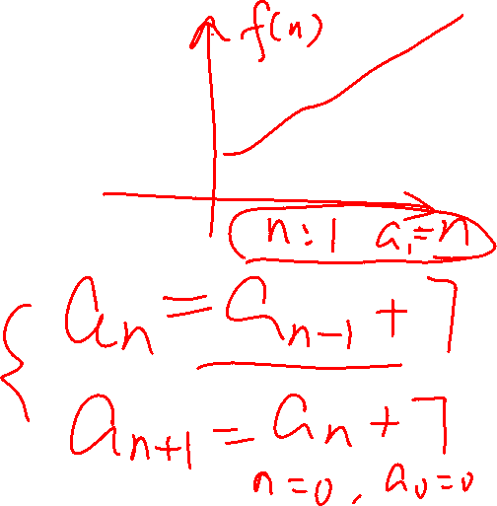
Questions on Lecture 9?

Slide 5
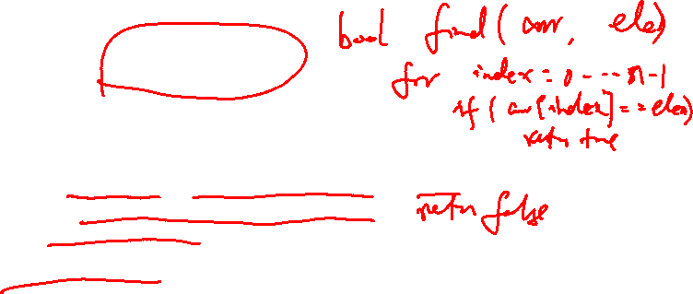
Analyzing the worst case
boolean find( String[] theList, String toFind ) {
for ( int i = 0; i < theList.length; i++ ) {
if ( theList[i].equals( toFind ))
return true;
}
return false;
}
How many instructions do you have to execute to find out if the element is in the list in the worst case, if n represents the length of the list?

Slide 6
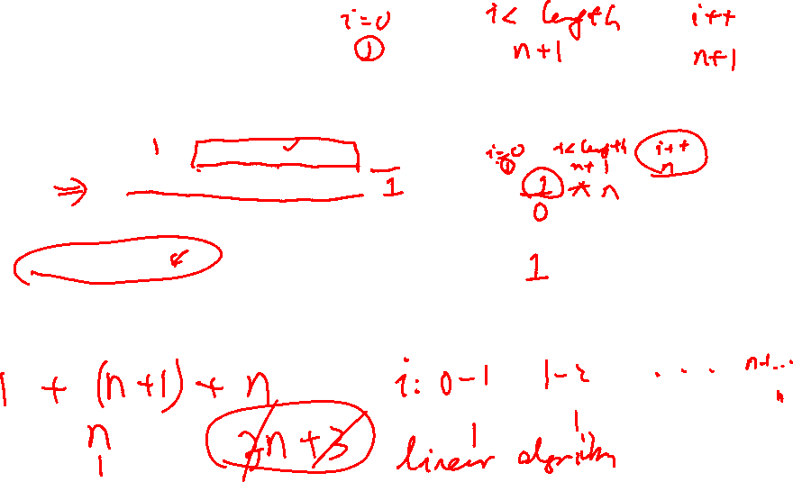
Analyzing the worst case
Code | # of instr.
boolean find( String[] theList, String toFind ) { | N/A
for ( int i = 0; i < theList.length; i++ ) {
if ( theList[i].equals( toFind ))
return true;
}
return false;
}
How many instructions do you have to execute to find out if the element is in the list in the worst case, if n represents the length of the list?

Slide 7
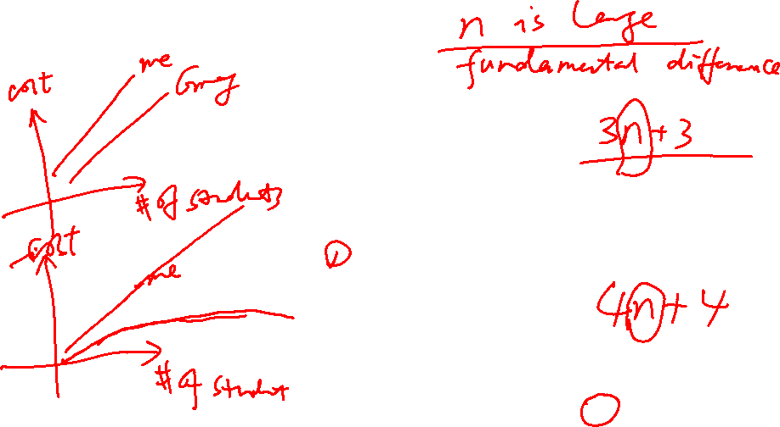
Analyzing the worst case
boolean find( String[] theList, String toFind ) {
for ( int i = 0; i < theList.length; i++ ) {
if ( theList[i].equals(toFind) )
return true;
}
return false;
}
boolean mysteryFind( String[] theList, String toFind ) {
int count = 0;
for ( int i = 0; i < theList.length; i++ ) {
count = count + 1;
if ( theList[i].equals(toFind) )
return true;
}
return false;
}
Which method is faster?
find
mysteryFind
They are about the same

Slide 8
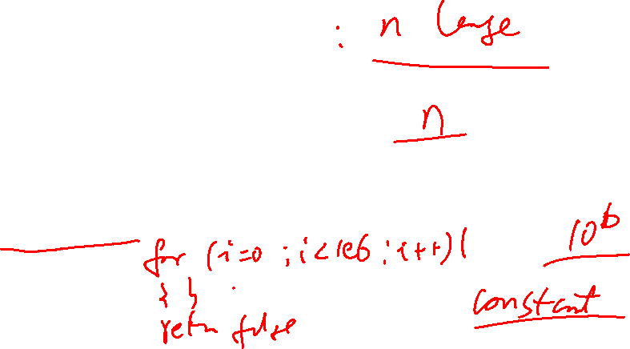
Analyzing the worst case
boolean find( String[] theList, String toFind ) {
for ( int i = 0; i < theList.length; i++ ) {
if ( theList[i].equals(toFind) )
return true;
}
return false;
}
boolean fastFind( String[] theList, String toFind ) {
return false;
}
Which method is faster?
find
fastFind
They are about the same

Slide 9
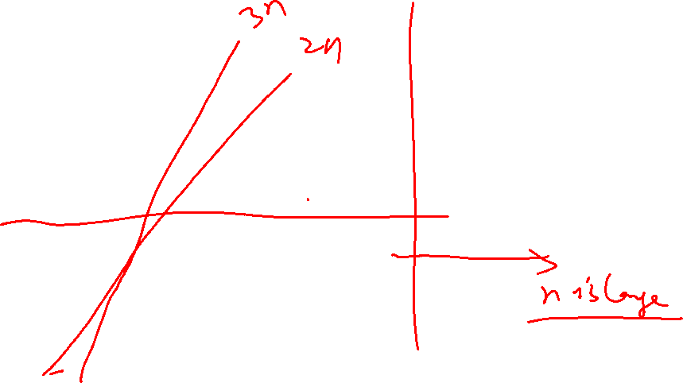
3n vs 2n vs 1
(Play)lists typically have 1000s (or more!) elements, so we only care about very large n.
find and mysteryFind are “more similar” than find and fastFind.
We use Big-O notation to represent “classes” of running time—e.g. those that have similar behavior as N gets large, give or take a constant factor.

Slide 10
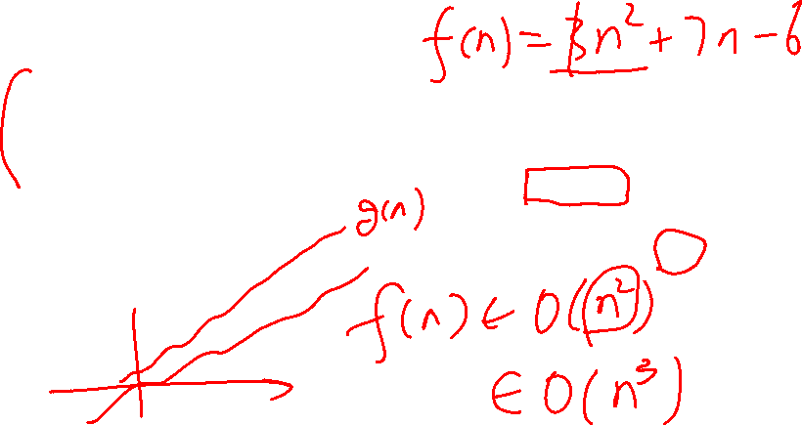
Steps for calculating the Big O (Theta, Omega) bound on code or algorithms
Count the number of instructions in your code (or algorithm) as precisely as possible as a function of n, which represents the size of your input (e.g. the length of the array). This is your f(n).
Make sure you know if you are counting best case, worst case or average case – could be any of these!
Simplify your f(n) to find a simple g(n) such that f(n) = O(g(n)) (or Ω(g(n) or Θ(g(n))

Slide 11
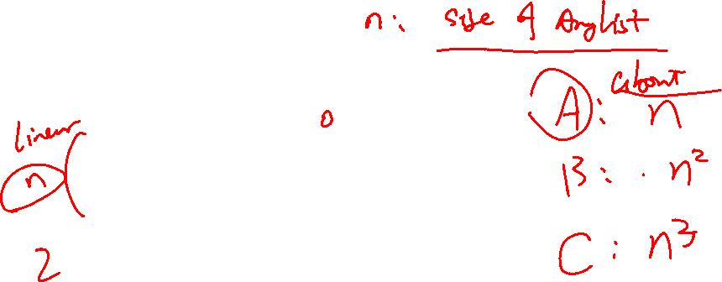
Counting Steps – ArrayList Insert – ignore EC
public void insert(int index, String s) {
expandCapacity(); //ignore
for (int i = size - 1; i >= index ; i--) {
this.elements[i+1] = this.elements[i];
}
this.elements[index] = s;
this.size += 1;
}

Slide 12
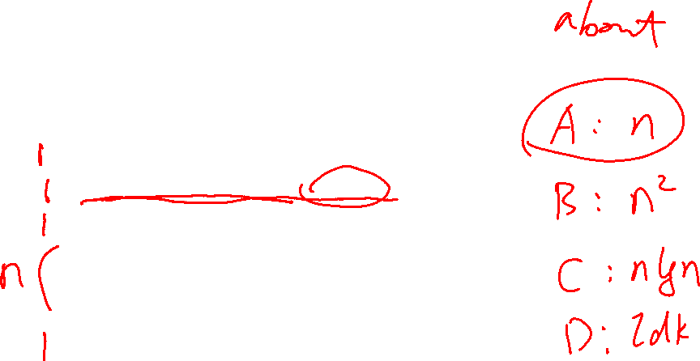
Counting Steps – ArrayList Expand Capacity
private void expandCapacity() {
int currentCapacity = this.elements.length;
if(this.size < currentCapacity) { return; }
String[] expanded = new String[currentCapacity * 2];
for(int i = 0; i < this.size; i += 1) {
expanded[i] = this.elements[i];
}
this.elements = expanded;
}

Slide 13
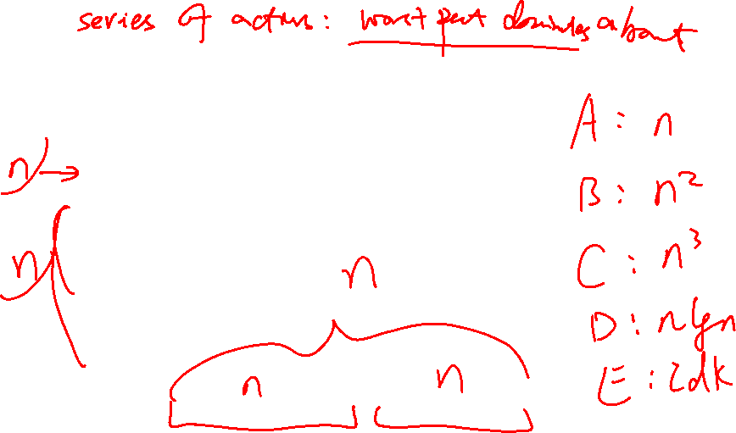
Counting Steps – ArrayList Insert w/ EC
public void insert(int index, String s) {
expandCapacity();
for (int i = size - 1; i >= index ; i--) {
this.elements[i+1] = this.elements[i];
}
this.elements[index] = s;
this.size += 1;
}

Slide 14
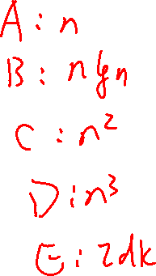
Challenge
void tricky(int n) {
int operations = 0;
while(n > 0) {
for(int i = 0; i < n; i++) {
cout << "Operations: " << operations++ << endl;
}
n /= 2;
}
}
What is the step counting result for the algorithm above?
Notes:
B

